Slide 1

BLPAPI-RDB

Slide 2
RDB-BLPAPI
Create a relational database in Microsoft Access for market data with the following tables:
Markets
Issuers
Stocks
Daily Data
Intraday Data
Retrieve Daily and Intraday Data from BLPAPI to populate the data tables.

Slide 3
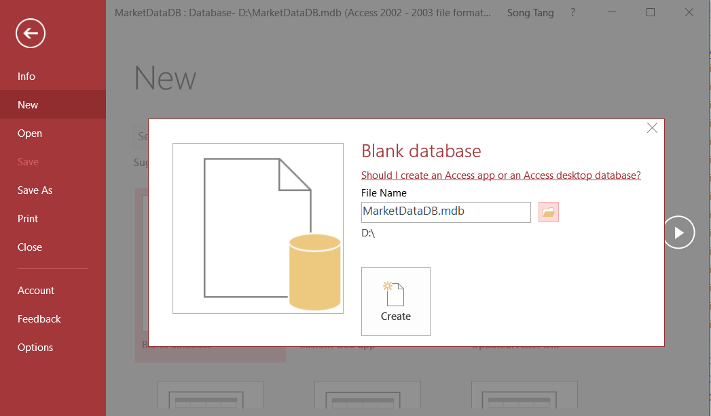
Create Market Data RDB
Use Microsoft Access Database to create a database called D:\MarketDataDB.mdb
Open Microsoft Access: File->New->Blank Database

Slide 4
Create Fields in a table
Select Table Design from Create
Enter field name
Must be unique, but only within the same table
Select field type from a menu
Use date/time for times
Use text for phone numbers
Designate primary key (right mouse button)
Save the table
That’s when you get to assign a table name

Slide 5
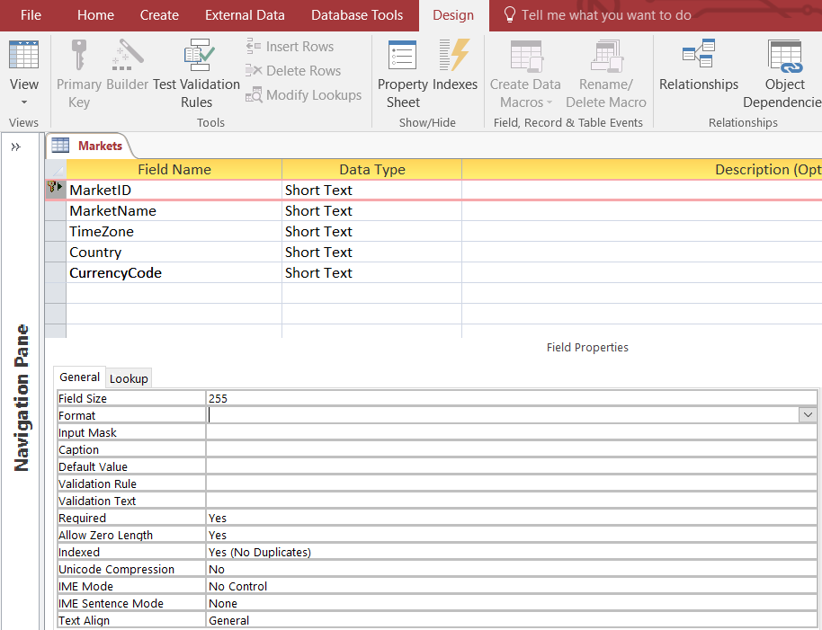

Slide 6
Enter Data
Open the table
Double-click on the icon
Enter new data in the bottom row
A new (blank) bottom row will appear
Close the table
No need to “save” – data is stored automatically
Import data from an Excel sheet

Slide 7
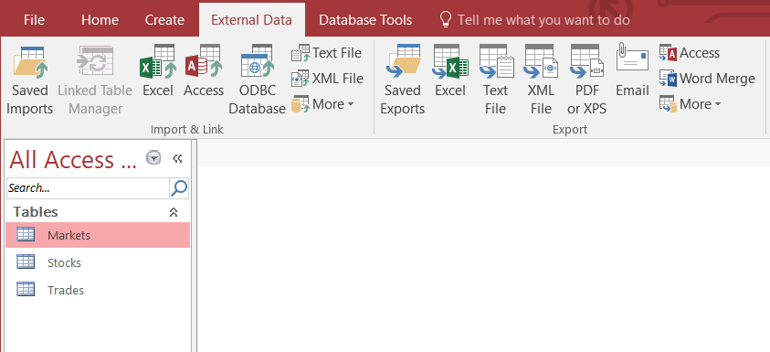
Input Data from Excel Sheets
Close your table first and select Excel as External Data for Market table.

Slide 8
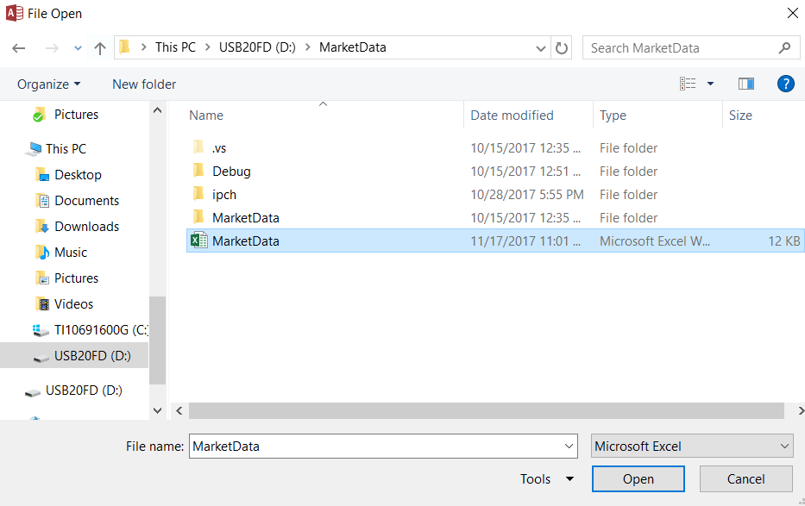

Slide 9
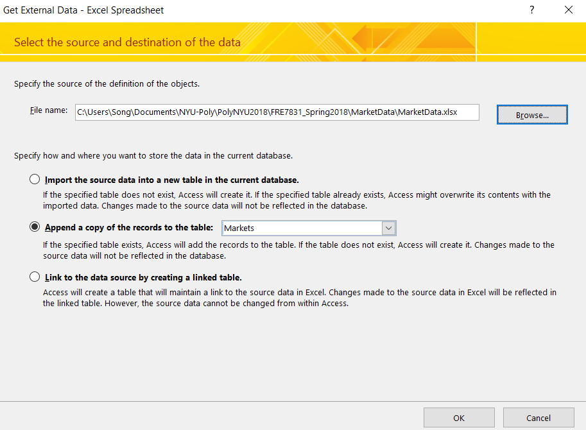

Slide 10
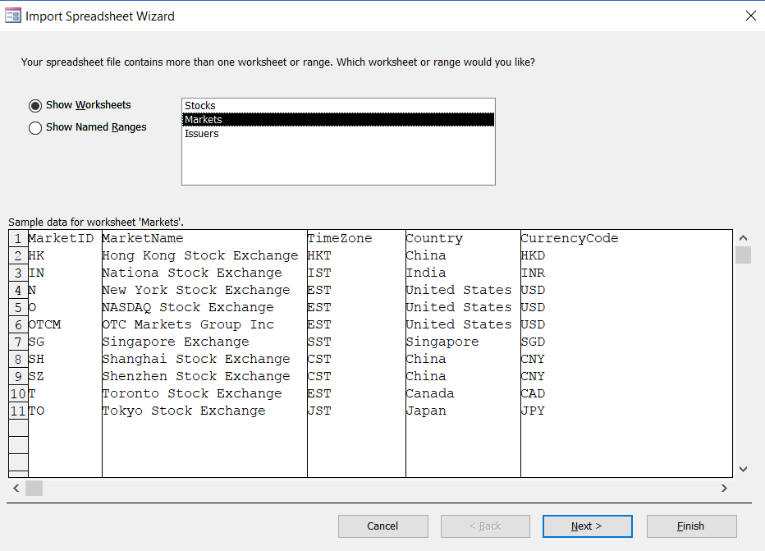

Slide 11
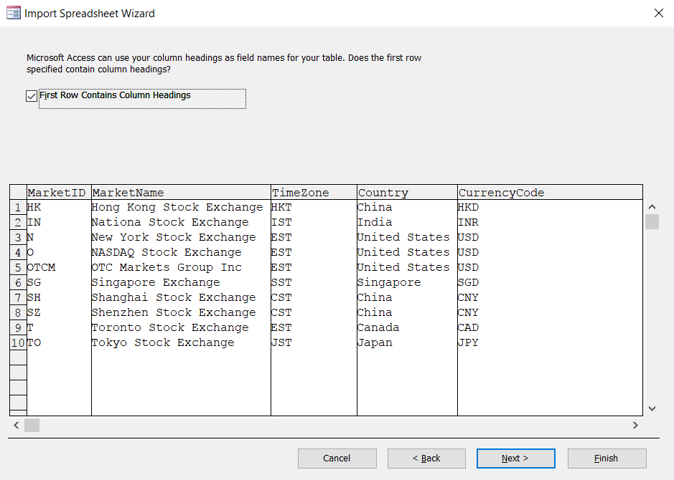

Slide 12
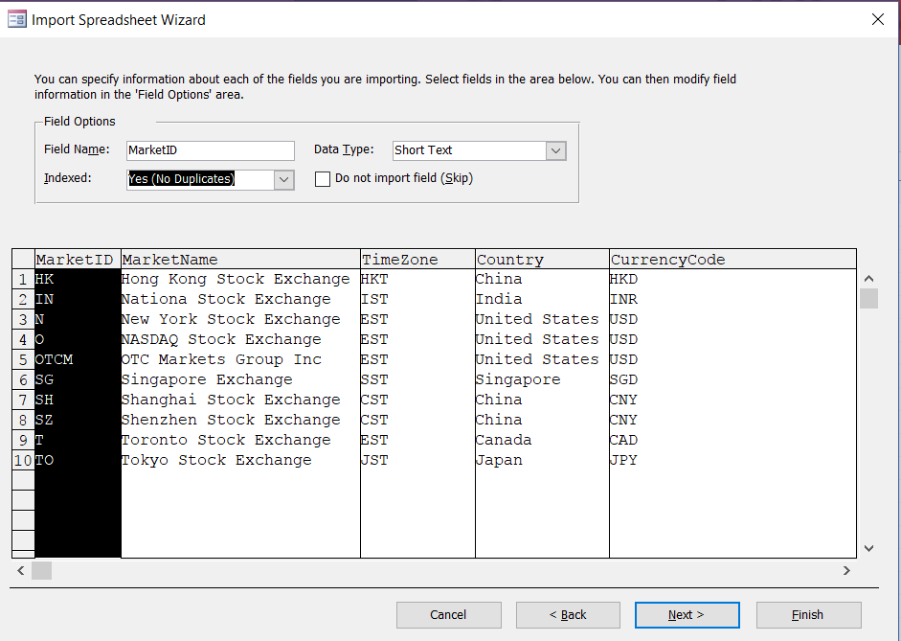

Slide 13
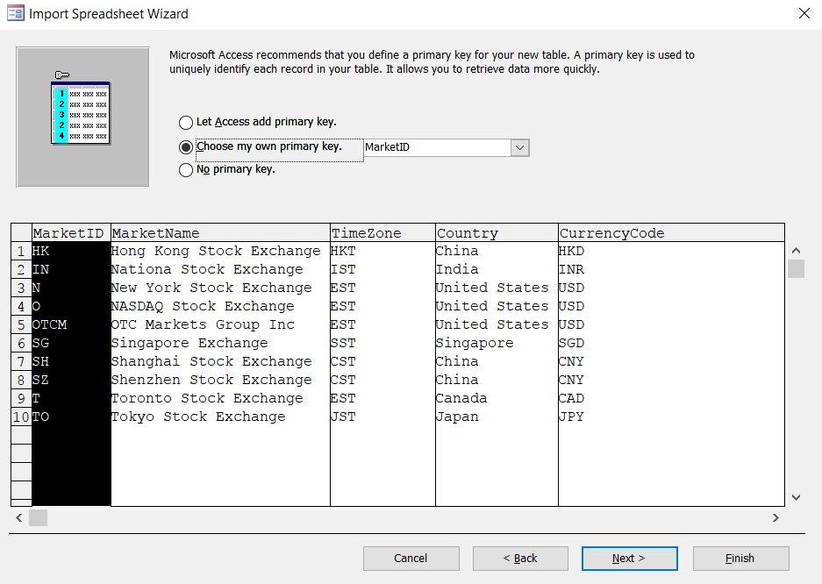

Slide 14
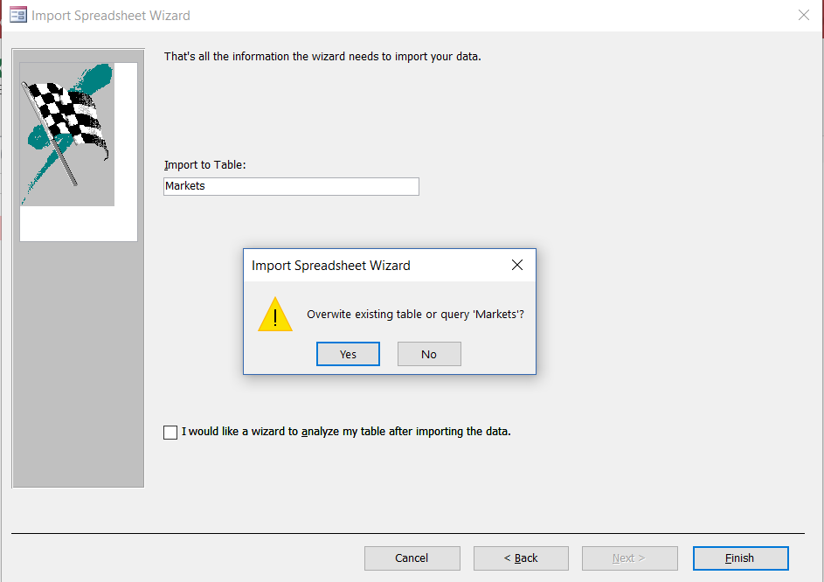
Click Yes to import the data from Excel sheet

Slide 15
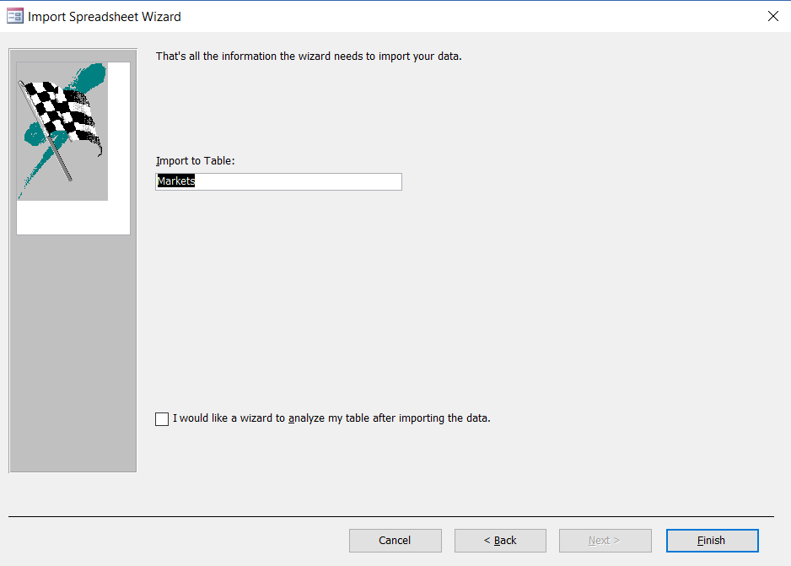

Slide 16
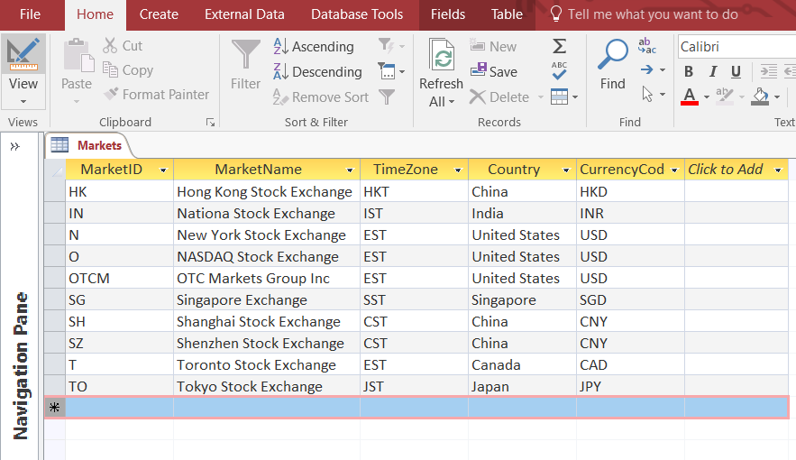

Slide 17
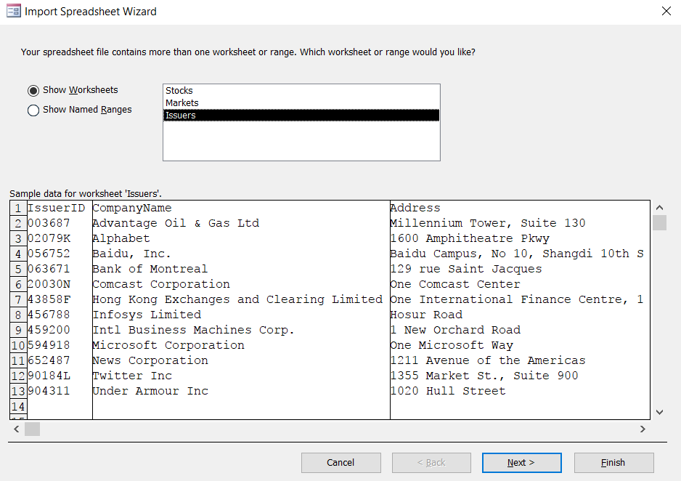
Repeat the Same Steps for the Table Issuers
Import Excel sheet Issuers without creating an empty table in Access

Slide 18
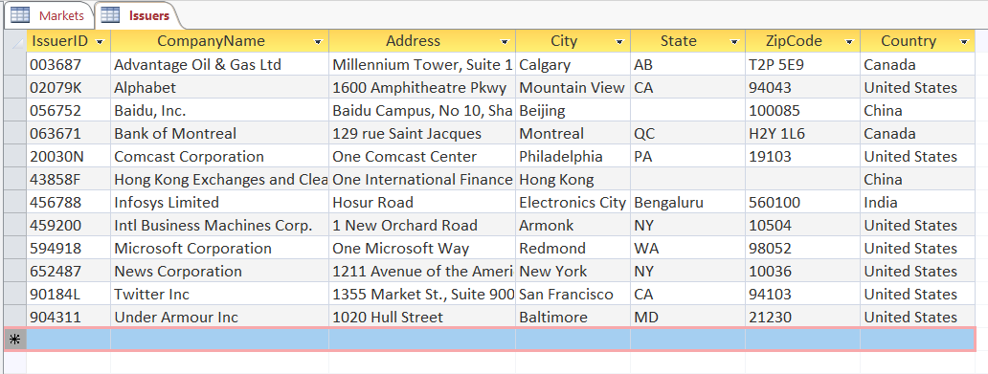
Imported table from Excel Sheet Issuers

Slide 19
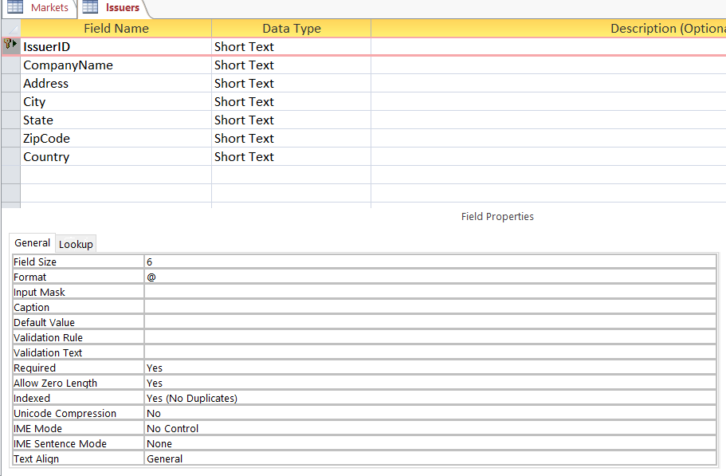
Add Restriction to Table Fields
Verify IssuerID is the primary key and its length is 6

Slide 20
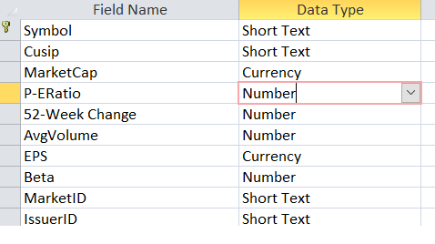
Continue with Stock Table
Create Stock table and Make sure the date type of each field matches the following before importing data from the Excel sheet.

Slide 21
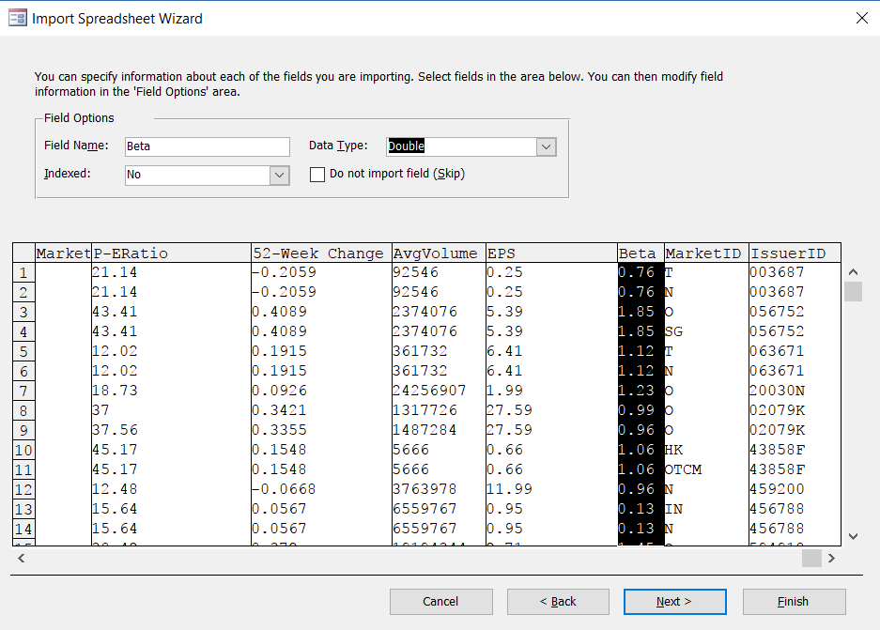

Slide 22
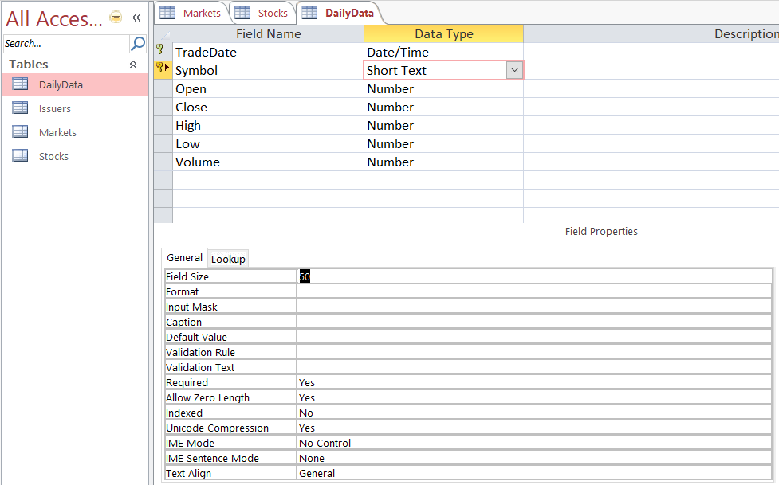
Create DailyData Table
Hold Ctl key to select both TradeData and Symbol as the composite Primary Key.

Slide 23
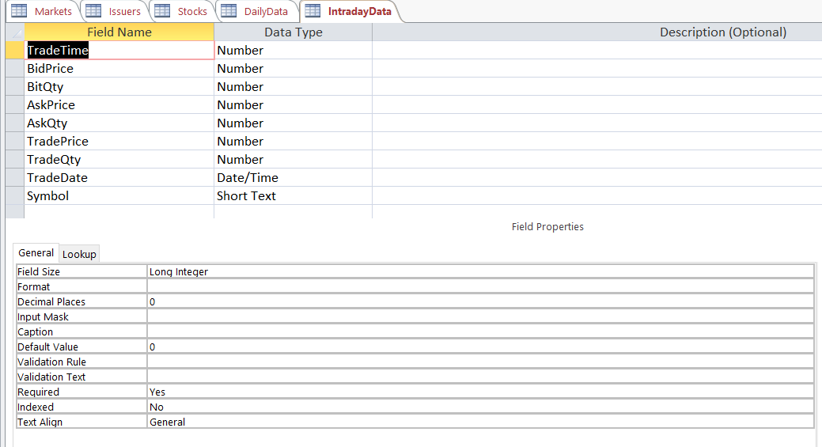
Create IntradyDayData table

Slide 24
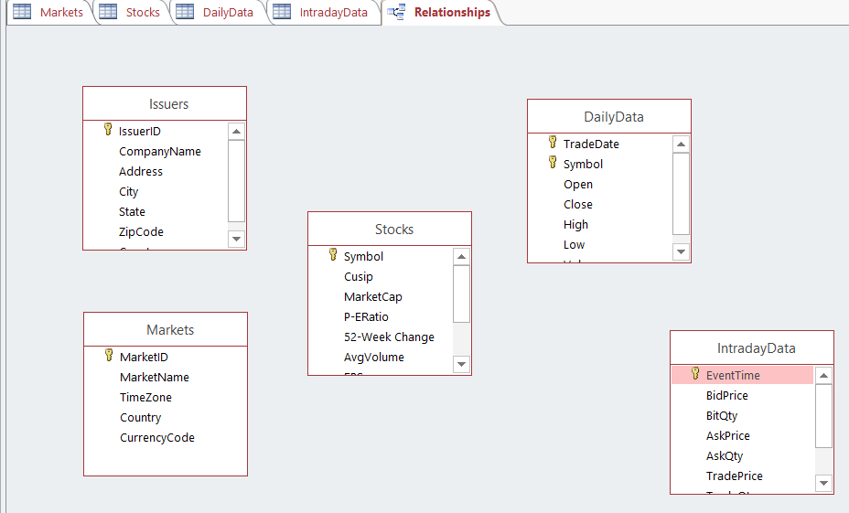
Entity-Relationship Diagram
Click Database Tools and Select Relationships. Close/Save all the tables
Drag all the tables in the diagram

Slide 25
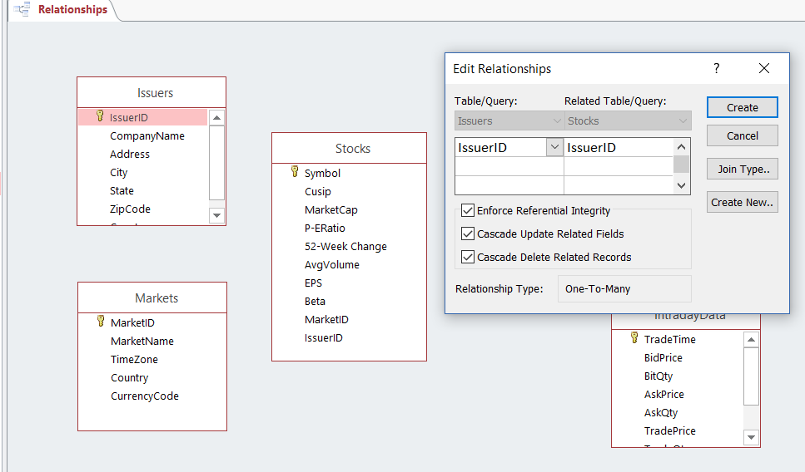
Create Relationship between Tables

Slide 26
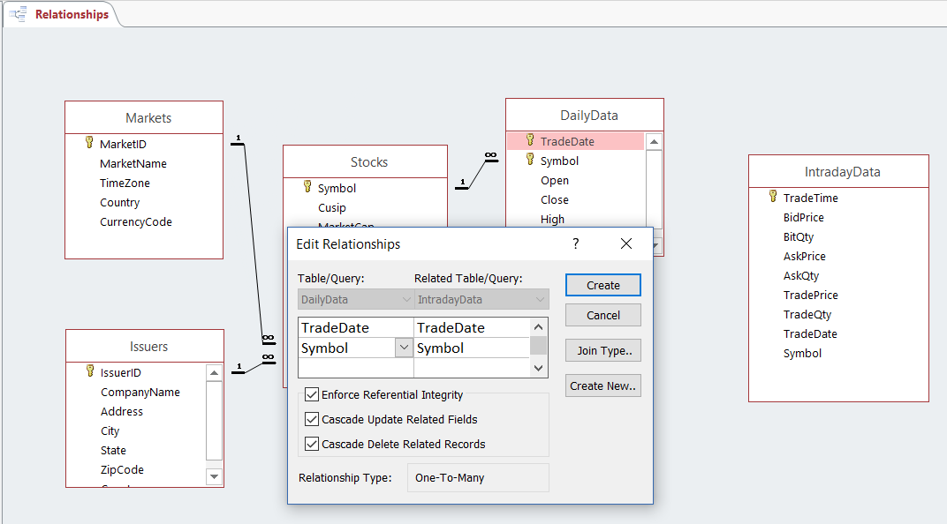

Slide 27
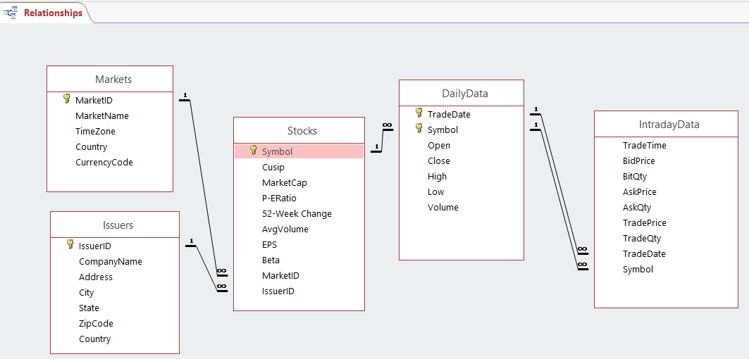
Completed E-R Diagram

Slide 28
Access Microsoft Access Database in C++ Program
Microsoft JET Engine
Data Access Technologies
OLE DB
ADO
DAO
ODBC

Slide 29
Microsoft JET Engine
A database engine is the underlying software component that a database management system (DBMS) uses to create, read, update and delete (CRUD) data from a database.
Microsoft Access uses JET as its underlying database engine.
We will use the data access application programming interface (API) in our C++ program to interact directly with JET without going through the user interface of the DBMS.

Slide 30
Data Access Technologies
OLE DB is a system-level programming interface for accessing data, and is the underlying technology for ADO.
ADO provides a COM-based application-level interface for OLE DB data providers. ADO supports a variety of development needs, including the creation of front-end database clients and middle-tier business objects using live connections to data in relational databases.
DAO provides access to JET (Access) databases. This API can be used from Microsoft Visual Basic, Microsoft Visual C++, and scripting languages.
ODBC is a low-level, high-performance C programming interface designed specifically for relational databases.

Slide 31
Data Access Technologies
The interaction between your C++ program and the ACCESS database, MarketDataDB is achieved by using ADO API interface. ADO consists of a series of objects that are used to invoke SQL query on the database from your C++ program directly.

Slide 32
Populate Data from BLPAPI
The program MarketData
Connect BLPAPI to retrieve history data and intraday data for a list of stocks
Connect to the relational database, MarketDataDB.mdb via ADO/OLE-DB
Parse the data from BLPAPI and populate the data tables in the database

Slide 33
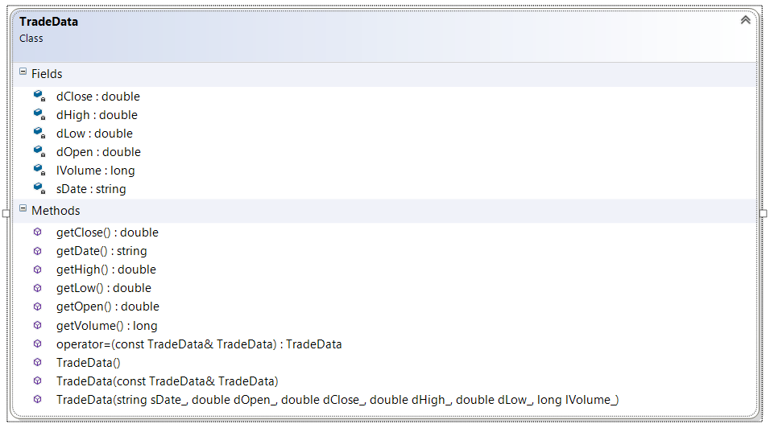

Slide 34
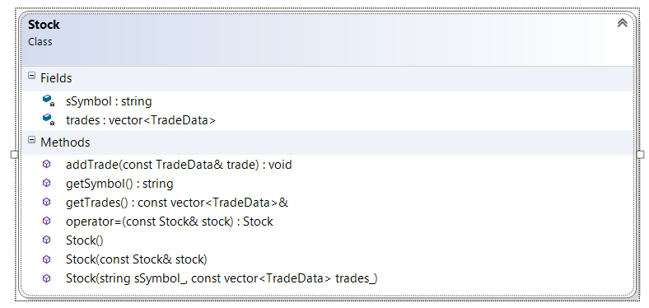

Slide 35
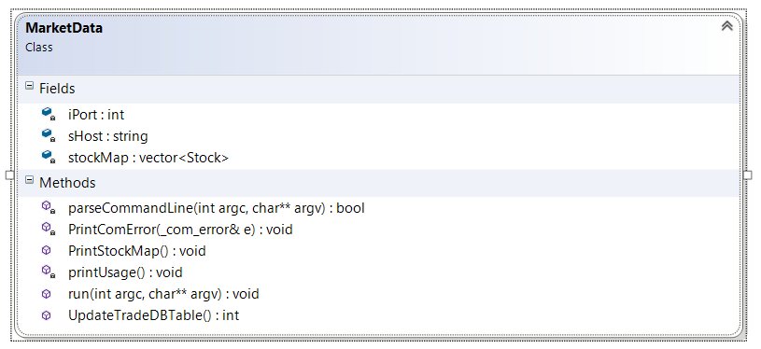

Slide 36
MarketData::Run() - Request Data for a list of stocks
Service refDataService = session.getService("//blp/refdata");
Request request =
refDataService.createRequest("HistoricalDataRequest");
request.getElement("fields").appendValue("OPEN");
request.getElement("fields").appendValue("LAST_TRADE");
request.getElement("fields").appendValue("VOLUME");
request.getElement("fields").appendValue("HIGH");
request.getElement("fields").appendValue("LOW");
request.set("periodicityAdjustment", "ACTUAL");
request.set("periodicitySelection", "DAILY");
request.set("startDate", "20171010");
request.set("endDate", "20171111");
request.set("maxDataPoints", 2000);

Slide 37
vector<string> stockList;
stockList.push_back("IBM");
stockList.push_back("MSFT");
string sSuffix = " US Equity";
vector<string>::iterator vitr = stockList.begin();
for (; vitr != stockList.end(); vitr++)
{
string sStock = *vitr + sSuffix;
request.getElement("securities").appendValue(sStock.c_str());
}
std::cout << "Sending Request: " << request << std::endl;
session.sendRequest(request);

Slide 38
MarketData:Run() - Parse the data
Element securityData = msg.getElement(SECURITY_DATA);
sSymbol = securityData.getElement("security").getValueAsString();
std::size_t found = sSymbol.find(" ");
if (found != std::string::npos)
sSymbol = sSymbol.substr(0, found);
Element fieldData = securityData.getElement(FIELD_DATA);
for (int i = 0; i < int(fieldData.numValues()); i++)
{ string sDate = fieldData.getValueAsElement(i).getElement("date").getValueAsString();
double fClose = fieldData.getValueAsElement(i).getElement("LAST_TRADE").getValueAsFloat64();
double fOpen = fieldData.getValueAsElement(i).getElement("OPEN").getValueAsFloat64();
double fHigh = fieldData.getValueAsElement(i).getElement("HIGH").getValueAsFloat64();
double fLow = fieldData.getValueAsElement(i).getElement("LOW").getValueAsFloat64();
long lVolume = (long)fieldData.getValueAsElement(i).getElement("VOLUME").getValueAsInt64();
TradeData aTrade(sDate, fClose, fOpen, fHigh, fLow, lVolume);
trades.push_back(aTrade); }
}
if (sSymbol.length() > 0)
stockMap.push_back(Stock(sSymbol, trades));

Slide 39
MarketData:UpdateTradeDBTable() – Populate table
ADODB::_ConnectionPtr pConnect("ADODB.Connection");
hResult = pConnect->Open(bstrConnect, "admin", "", ADODB::adConnectUnspecified);
if (SUCCEEDED(hResult))
{
char sQuery[256];
memset((void*)sQuery, '\0', 256);
sprintf_s(sQuery, "DELETE * FROM DailyData;");
ADODB::_RecordsetPtr pRecSet("ADODB.Recordset");
hResult = pRecSet->Open(sQuery, _variant_t((IDispatch *)pConnect, true), ADODB::adOpenUnspecified,
ADODB::adLockUnspecified, ADODB::adCmdText);

Slide 40
memset((void*)sQuery, '\0', 256);
for (vector<Stock>::iterator mIt = stockMap.begin(); mIt != stockMap.end(); mIt++)
{
string sSymbol = mIt->getSymbol();
vector<TradeData> trades = mIt->getTrades();
for (vector<TradeData>::iterator vIt = trades.begin(); vIt != trades.end(); vIt++)
{ string sDate = vIt->getDate();
double dOpen = vIt->getOpen();
double dClose = vIt->getClose();
double dHigh = vIt->getHigh();
double dLow = vIt->getLow();
long lVolume = vIt->getVolume();
sprintf_s(sQuery, "INSERT INTO DailyData VALUES('%s','%s',%.2f,%.2f,%.2f,%.2f,%ld);", sDate.c_str(), sSymbol.c_str(), dOpen, dClose, dHigh, dLow, lVolume); ADODB::_RecordsetPtr pRecSet("ADODB.Recordset");
hResult = pRecSet->Open(sQuery, _variant_t((IDispatch *)pConnect, true), ADODB::adOpenUnspecified,
ADODB::adLockUnspecified, ADODB::adCmdText); }
}

Slide 41
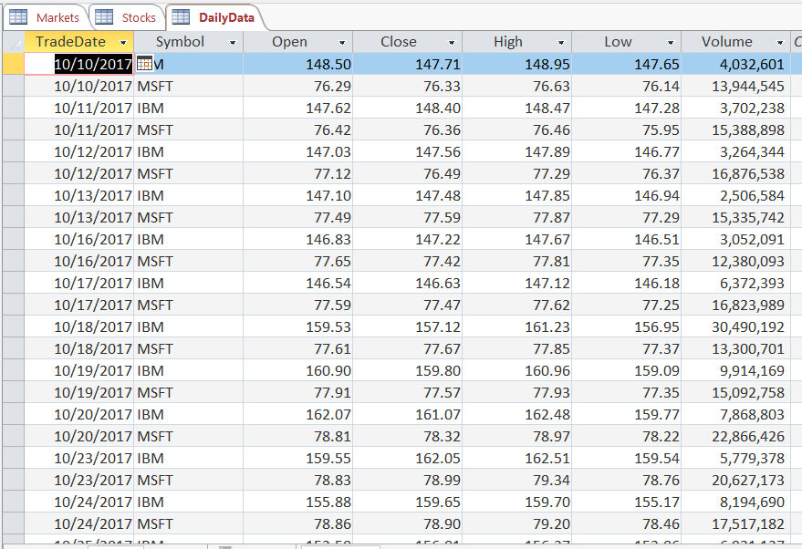
DailyData table populated via BLPAPI

